Slide 1
What All Codes Should Do: Overview of Best Practices in HPC Software Development
ATPESC 2019
Katherine Riley
Director of Science, Argonne Leadership Computing Facility Argonne National Laboratory
Q Center, St. Charles, IL (USA) August 8, 2019

Slide 2

License, citation, and acknowledgments
License and Citation
This work is licensed under a Creative Commons Attribution 4.0 International License (CC BY 4.0).
Requested citation: Katherine Riley, What All Codes Should Do: Overview of Best Practices in HPC Software Development, in Better Scientific Software Tutorial, Argonne Training Program on Extreme-Scale Computing (ATPESC), St. Charles, IL, 2019. DOI: 10.6084/m9.figshare.9272813.
Acknowledgements
This work was supported by the U.S. Department of Energy Office of Science, Office of Advanced Scientific Computing Research (ASCR), and by the Exascale Computing Project (17-SC-20-SC), a collaborative effort of the U.S. Department of Energy Office of Science and the National Nuclear Security Administration.
This work was performed in part at the Argonne National Laboratory, which is managed by UChicago Argonne, LLC for the U.S. Department of Energy under Contract No. DE-AC02-06CH11357

Slide 3
Good Scientific Process Requires Good Software Practices Good Software Practices Will Increase Science Productivity

Slide 4
Notes:
Engineering mistakes happen. They can be huge but of course they happen on smaller scales too.
Most engineering mistakes are not made on purpose.
Both of these are interesting because there was a disconnect between the experts and the politics.. But not all are

Slide 5
Notes:
Y2K was because people did not plan for code lasting that long. Or it did not occur to them.

Slide 6
Notes:
The Mars Climate Orbiter was a satellite meant to collect data on Mars for two Earth years (about one Martian year) and act as a relay station for data from the Mars Polar Lander. Launched in December 1998, the Orbiter was set to arrive at the Red Planet later the next year. But on September 23, 1999, NASA announced the orbiter was lost.
the failure of NASA’s systems engineering, and the checks and balances in our processes, to detect the error. UNITS PROBLEM between ground based software and the orbiter
Let’s connect this to your work – there are people here who are designing nuclear reactors, working on the design of million or billion dollar experiments, but also many are not. But all the lessons of best practices are still crucial for the scientific process and productive use of developer and compute time

Slide 7
rt
Notes:
This point is crucial. As the Director of Science for a supercomputing facility, I work about the time on these systems being used productively.
100s of millions to build these systems
Millions to keep them running.
COMPARABLE TO LHC – the lifetime of the experimental facility is longer. Budget $9B – but over more than a decade. 200MW but does not run 365 days/year

Slide 8
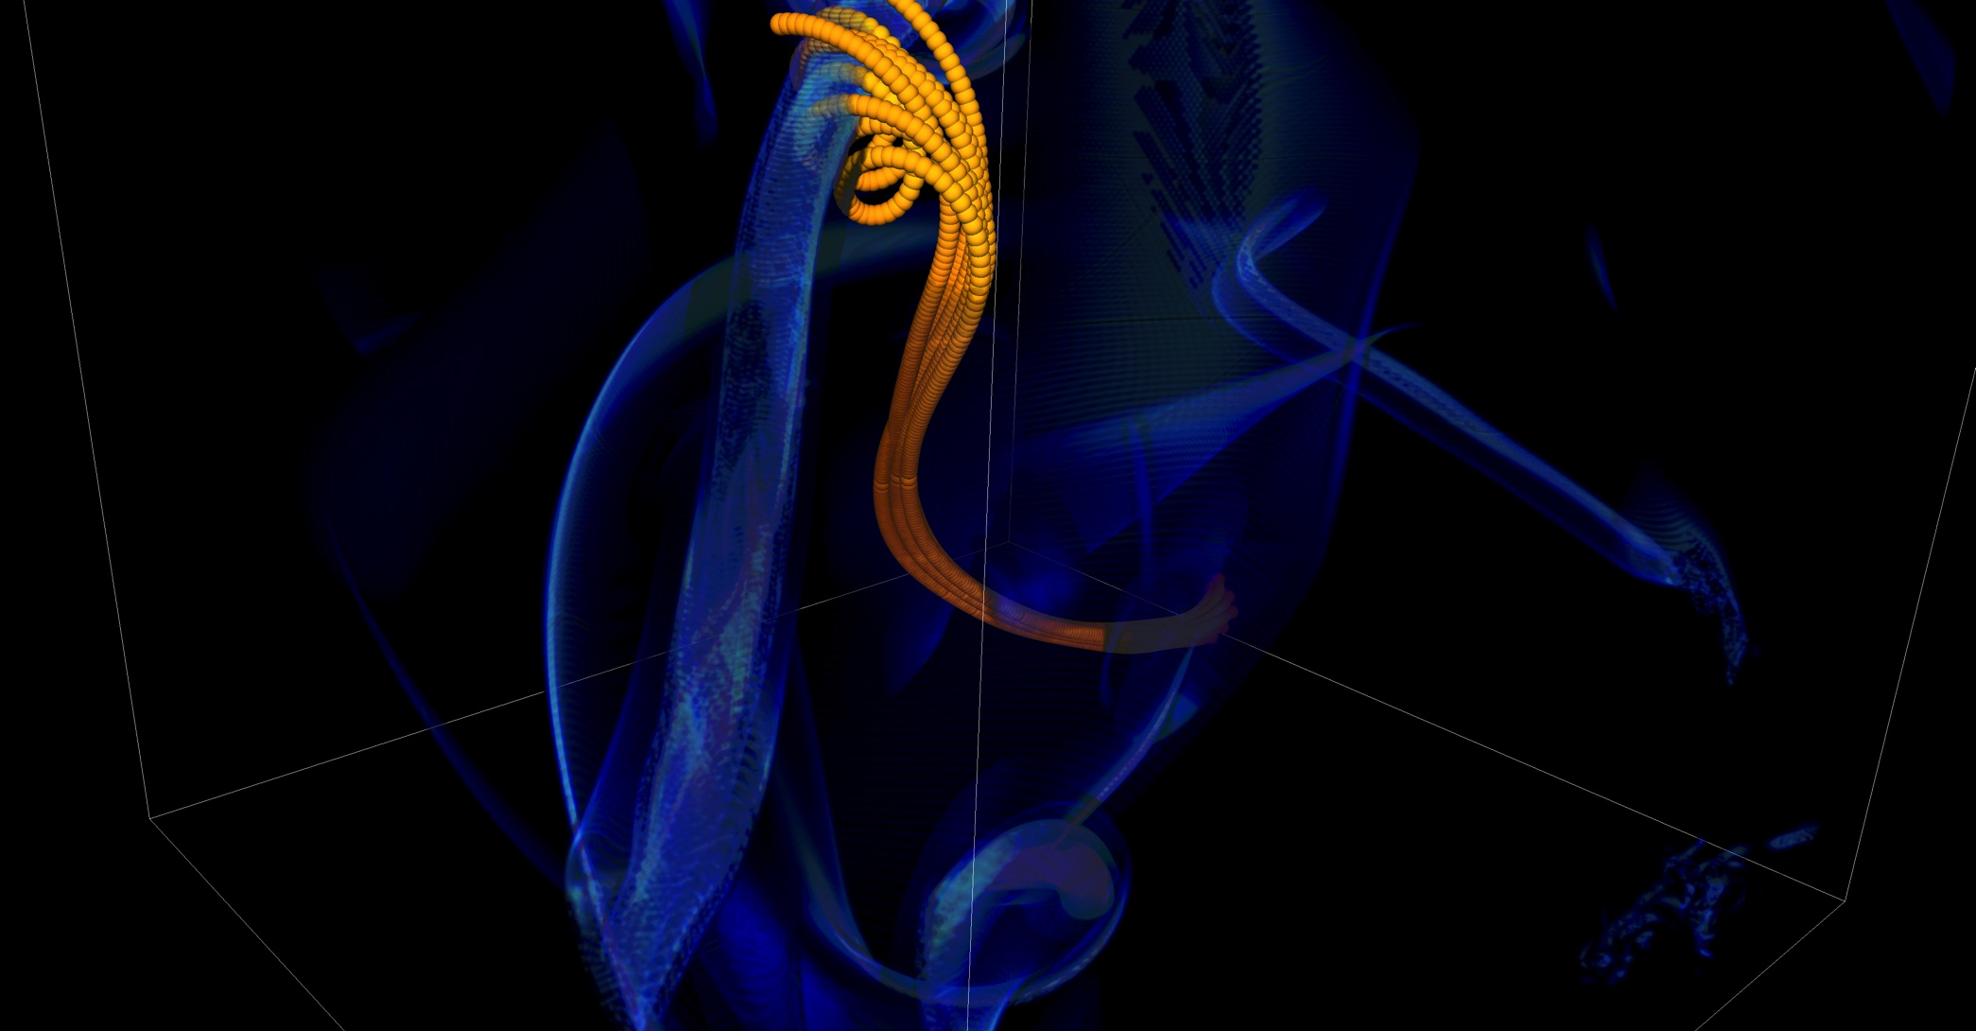
Mitigate Risk But It Is Never Zero
Short notice availability of one of the biggest machines of it’s time
< 1month to get ready, run was 1.5 weeks
Quick and dirty development of particle capability in code
Error in tracking particles resulted in duplicated tags from round-off
Had to develop post-processing tools to correctly identify trajectories
6 months to process results
FLASH had a software process in place. It was tested regularly. This was one instance when the full process could not be applied because of time constraints.
Notes:
2005, BG/L
This was not even a situation like retracting results

Slide 9
Objectives of the Session
To bring knowledge of useful software engineering practices to HPC scientific code developers
Not to prescribe any set of practices as must use
Be informative about practices that have worked for some projects
Emphasis on adoption of practices that help productivity rather than put unsustainable burden
Customization as needed – based on information made available
Your code will live longer than you expect.
Prepare for this.
Your science campaigns have real costs.
Think of the consequences.
Notes:
Links to the registration page, and also also the training pages

Slide 10
Agenda
Time | Module | Topic | Speaker
9:30am-10:15am | 01 | Objectives, Motivation, & Overview | Katherine Riley, ANL
10:15am-10:45am |  | Break
10:45am-11:30am | 02 | Requirements & Test-Driven Development | Jared O’Neal, ANL
11:30am-12:30pm | 03 | Software Design & Testing | Anshu Dubey, ANL
12:30pm-1:30pm |  | Lunch
1:30pm-2:15pm | 04 | Licensing | James Willenbring, SNL
2:15pm-3:15pm | 05 | Agile Methodologies & Useful GitHub Tools | James Willenbring, SNL
3:15pm-3:45pm |  | Break
3:45pm-4:15pm | 06 | Git Workflows | Jared O’Neal, ANL
4:15pm-4:55pm | 07 | Code Coverage & Continuous Integration | Jared O’Neal, ANL
4:55pm-5:30pm | 08 | Software Refactoring & Documentation | Anshu Dubey, ANL

Slide 11
Heroic Programming
Usually a pejorative term, is used to describe the expenditure of huge amounts of (coding) effort by talented people to overcome shortcomings in process, project management, scheduling, architecture or any other shortfalls in the execution of a software development project in order to complete it. Heroic Programming is often the only course of action left when poor planning, insufficient funds, and impractical schedules leave a project stranded and unlikely to complete successfully.
From http://c2.com/cgi/wiki?HeroicProgramming
Science teams often resemble heroic programming
Many do not see anything wrong with that approach
Notes:
Anecdote about offer to help with the development and get told a postdoc will do it because this is what we do.

Slide 12
What is wrong with heroic programming
Scientific results that could be obtained with heroic programming have run their course, because:
It is not possible for a single person to take on all these roles
Better scientific understanding
Math model
More Complex Computers
More complex software
Numerics
Different roles
and responsibilities
Verification
Performance

Slide 13
In Extreme-Scale science
Codes aiming for higher fidelity modeling
More complex codes, simulations and analysis
More moving parts that need to interoperate
Variety of expertise needed – the only tractable development model is through separation of concerns
It is more difficult to work on the same software in different roles without a software engineering process
Onset of higher platform heterogeneity
Requirements are unfolding, not known a priori
The only safeguard is investing in flexible design and robust software engineering process
Notes:
Numerical models

Slide 14
In Extreme-Scale science
Codes aiming for higher fidelity modeling
More complex codes, simulations and analysis
More moving parts that need to interoperate
Variety of expertise needed – the only tractable development model is through separation of concerns
It is more difficult to work on the same software in different roles without a software engineering process
Onset of higher platform heterogeneity
Requirements are unfolding, not known a priori
The only safeguard is investing in flexible design and robust software engineering process
Supercomputers change fast
Especially Now
Notes:
Numerical models

Slide 15
Technical Debt
Consequence of Choices
Quick and dirty collects interest which means more effort required to add features.
Accretion leads to unmanageable software
Increases cost of maintenance
Parts of software may become unusable over time
Inadequately verified software produces questionable results
Increases ramp-on time for new developers
Reduces software and science productivity due to technical debt

Slide 16
"... it seems likely that signiﬁcant software contributions to existing scientiﬁc software projects are not likely to be rewarded through the traditional reputation economy of science. Together these factors provide a reason to expect the over-production of independent scientiﬁc software packages, and the underproduction of collaborative projects in which later academics build on the work of earlier ones."
Howison & Herbsleb (2011)

Slide 17
Challenges Developing a Scientific Application
Technical
Sociological
All parts of the cycle can be under research
Requirements change throughout the lifecycle as knowledge grows
Verification complicated by floating point representation
Real world is messy, so is the software
Competing priorities and incentives
Limited resources
Perception of overhead without benefit
Need for interdisciplinary interactions

Slide 18
Customizations For Science Applications
Testing does not follow specific methods as understood by the software engineering research community
The extent and granularity reflective of project priorities and team size
Larger teams have more formalization
Lifecycle of science compare to lifecycle of development
Development model
Mostly ad-hoc, some are close to agile model, but none follows it explicitly
Much more responsive to the needs of the lifecycle

Slide 19
Lifecycle of Scientific Application
Modeling
Approximations
Discretizations
Numerics
Convergence
Stability
Implementation
Verification
Expected behavior
Validation
Experiment/observation

Slide 20
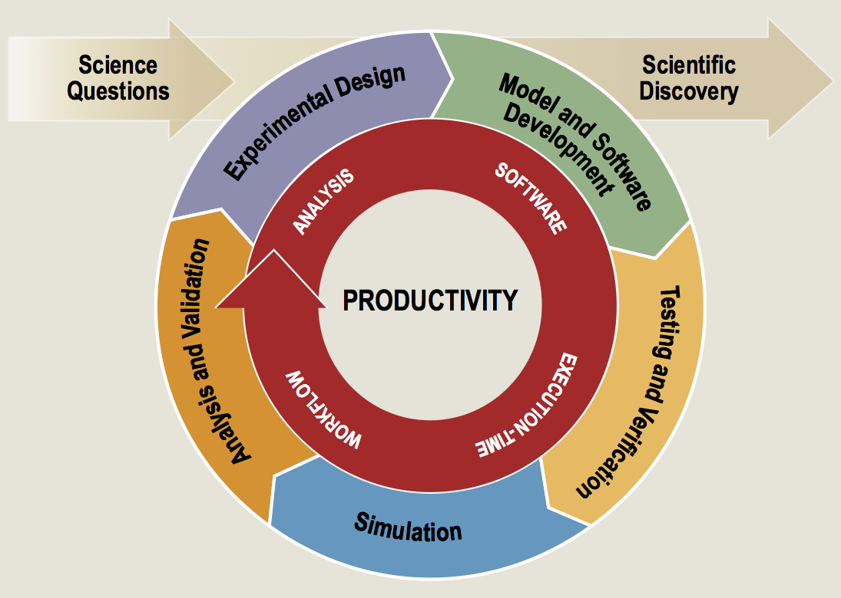
Software productivity cycle
http://www.orau.gov/swproductivity2014/SoftwareProductivityWorkshopReport2014.pdf

Slide 21
Software Process Best Practices
Baseline
Desirable
Invest in extensible code design
Use version control and automated testing
Institute a rigorous verification and validation regime
Define coding and testing standards
Clear and well defined policies for
Auditing and maintenance
Distribution and contribution
Documentation
Provenance and reproducibility
Lifecycle management
Open development and frequent releases

Slide 22
A Useful Resource
https://ideas-productivity.org/resources/howtos/
‘What Is’ docs: 2-page characterizations of important topics for SW projects in computational science & engineering (CSE)
‘How To’ docs: brief sketch of best practices
Emphasis on ``bite-sized'' topics enables CSE software teams to consider improvements at a small but impactful scale
We welcome feedback from the community to help make these documents more useful

Slide 23
Other resources
http://www.software.ac.uk/
http://software-carpentry.org/
http://flash.uchicago.edu/cc2012/
http://journals.plos.org/plosbiology/article?id=10.1371/journal.pbio.1001745
http://ieeexplore.ieee.org/xpls/icp.jsp?arnumber=4375255
http://www.orau.gov/swproductivity2014/SoftwareProductivityWorkshopReport2014.pdf
http://ieeexplore.ieee.org/xpl/articleDetails.jsp?arnumber=6171147

Slide 24
Why Community Codes?
Scientists can focus on developing for their algorithmic needs
Infrastructural provided
Graduate students do not start developing codes from scratch
Look at the available public codes and converge on the ones that most meet their needs
Look at the effort of customization for their purposes
Select the public code, and build upon it as they need
Cannot absolve researcher of understanding components
Just don’t have to develop each method
Methods that are so well understood there is little research
Notes:
Important to remember that they still need to understand the components developed by others that they are using, they just don’t have to actually develop everything themselves.
And this is particularly true of pesky detailed infrastructure/solvers that are too well understood to have any research component, but are time consuming to implement right

Slide 25
Why Community Codes Continued
Researchers can build upon work of others and get further faster, instead of reinventing the wheel
Code component re-use
No need to become an expert in every numerical technique
More reliable results because of more stress tested code
Enough eyes looking at the code will find any errors faster
New implementations take several years to iron out the bugs and deficiencies
Different users use the code in different ways and stress it in different ways
Open-source science results in more reproducible results
Generally good for the credibility

Slide 26
Communities Do Use Community Codes
Astrophysics, Molecular Dynamics, Chemistry, Climate, etc
Community/open-source approach more common in areas which need multi-physics and/or multi-scale
A visionary sees the benefit of software re-use and releases the code
Sophistication in modeling advances more rapidly in such communities
Others keep their software close for perceived competitive advantage
Repeated re-invention of wheel
General advancement of model fidelity slower

Slide 27
Good software practices are needed for scientific productivity
Science at extreme-scales is complex and requires multiple expertise
Software process does need to address reality
Open codes, community contribution, are powerful tools

Slide 28
Questions

